Slide 1

New Cube Design Example
7.5.2024 version 1.0

Slide 2
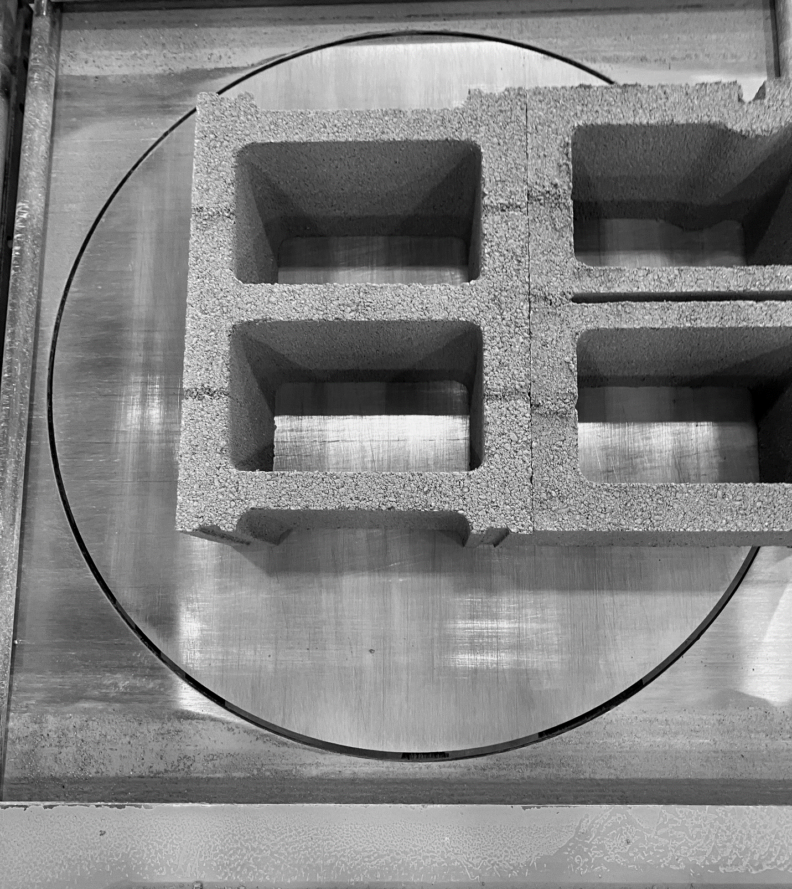
Assumptions and Prerequisite
Machine is on and running
Supplies Needed
Standard PPE

Slide 3
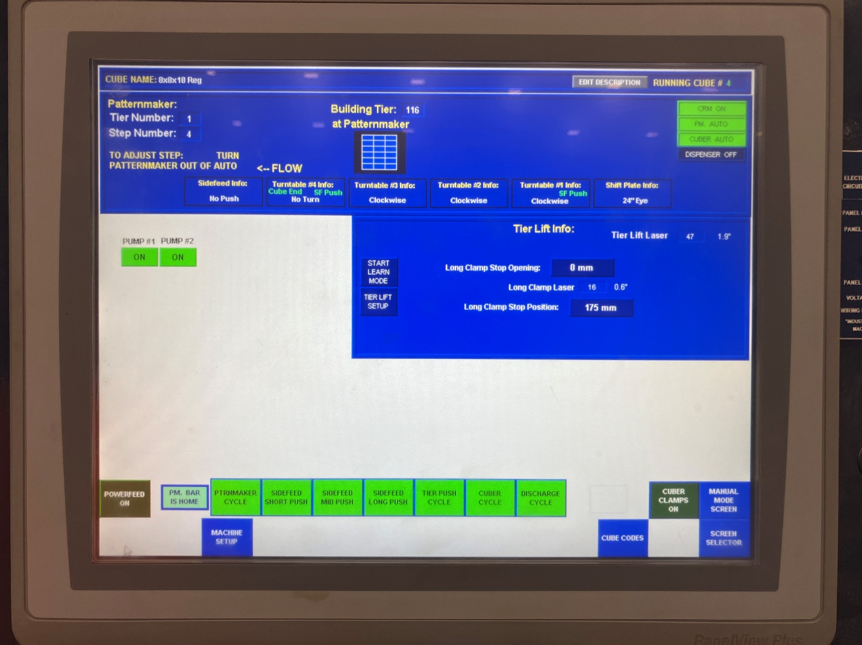
1. On the home screen of the cuber panel, we will start by selecting the “Screen Selector” in the bottom right corner of the screen (Figure 1).
Figure 1

Slide 4
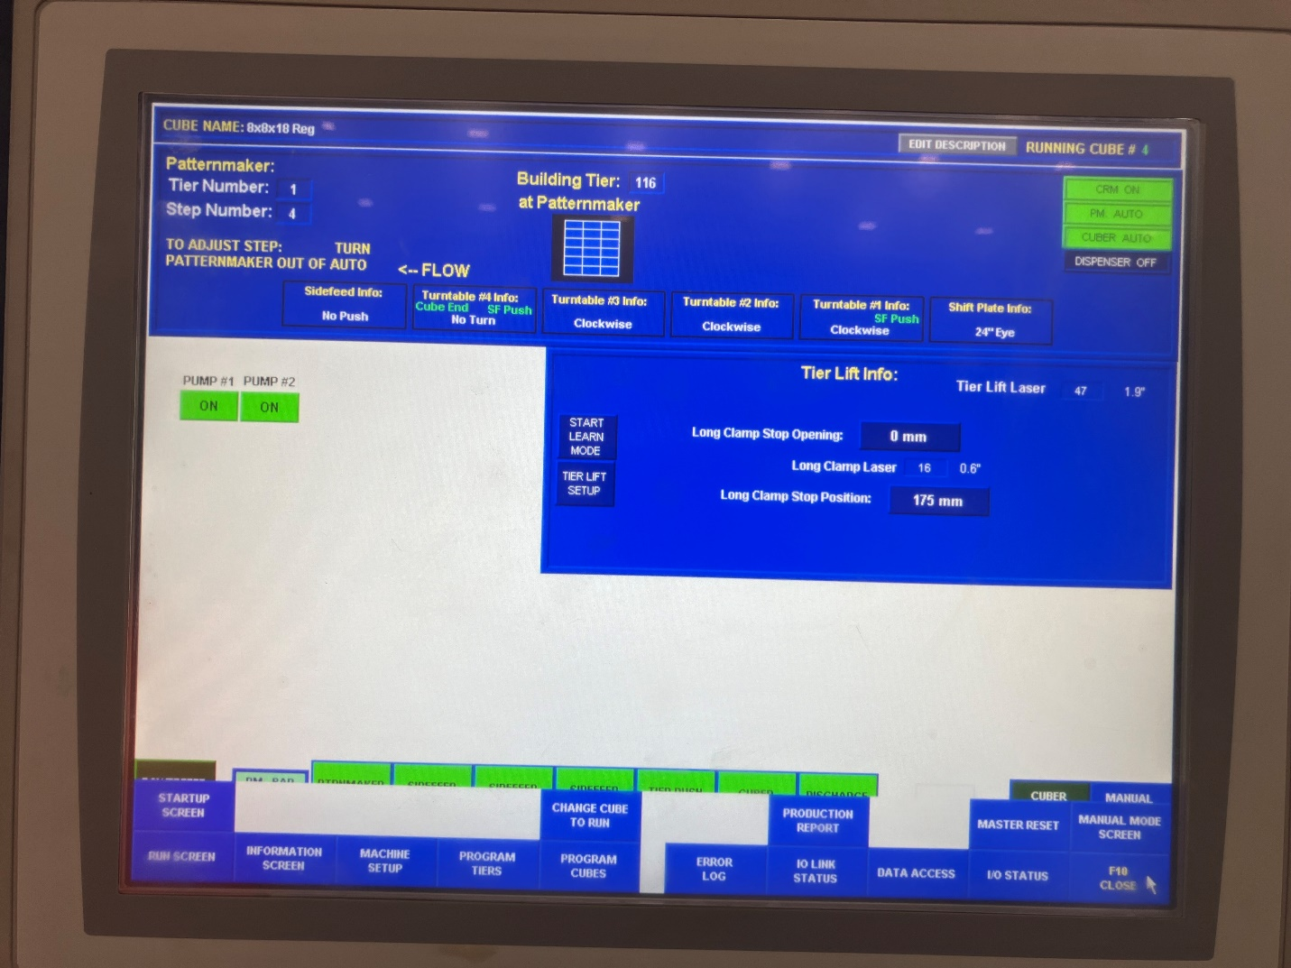
2. From the options that appear at the bottom of the screen, choose the “Program Cube” button (red circle, Figure 2).
Figure 2

Slide 5
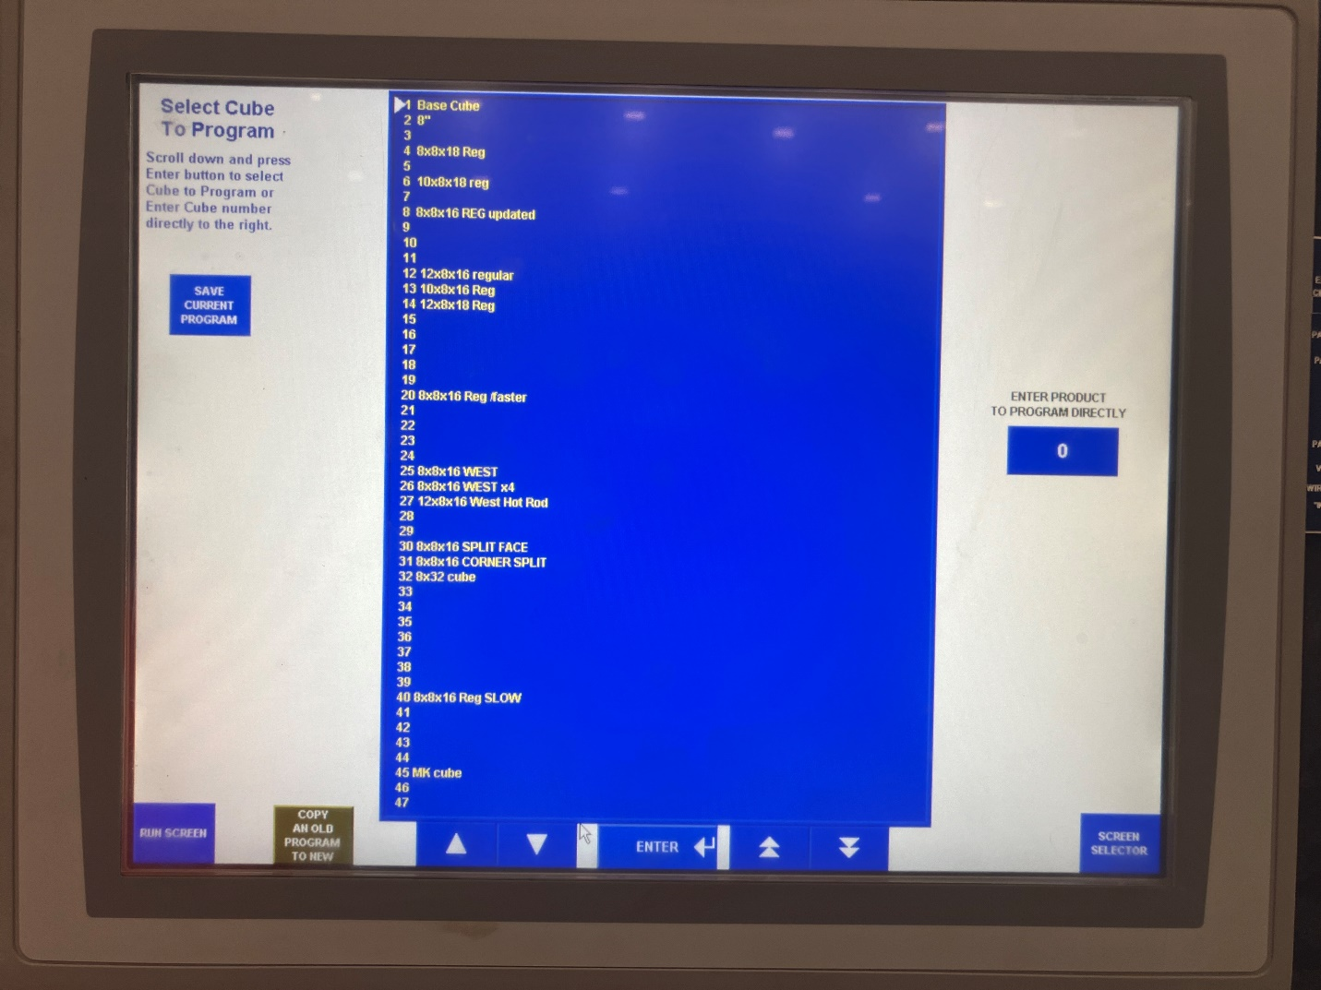
3. From the list of numbers to choose from, choose a number that is empty. For this example, we will be using number 47.
Figure 3

Slide 6
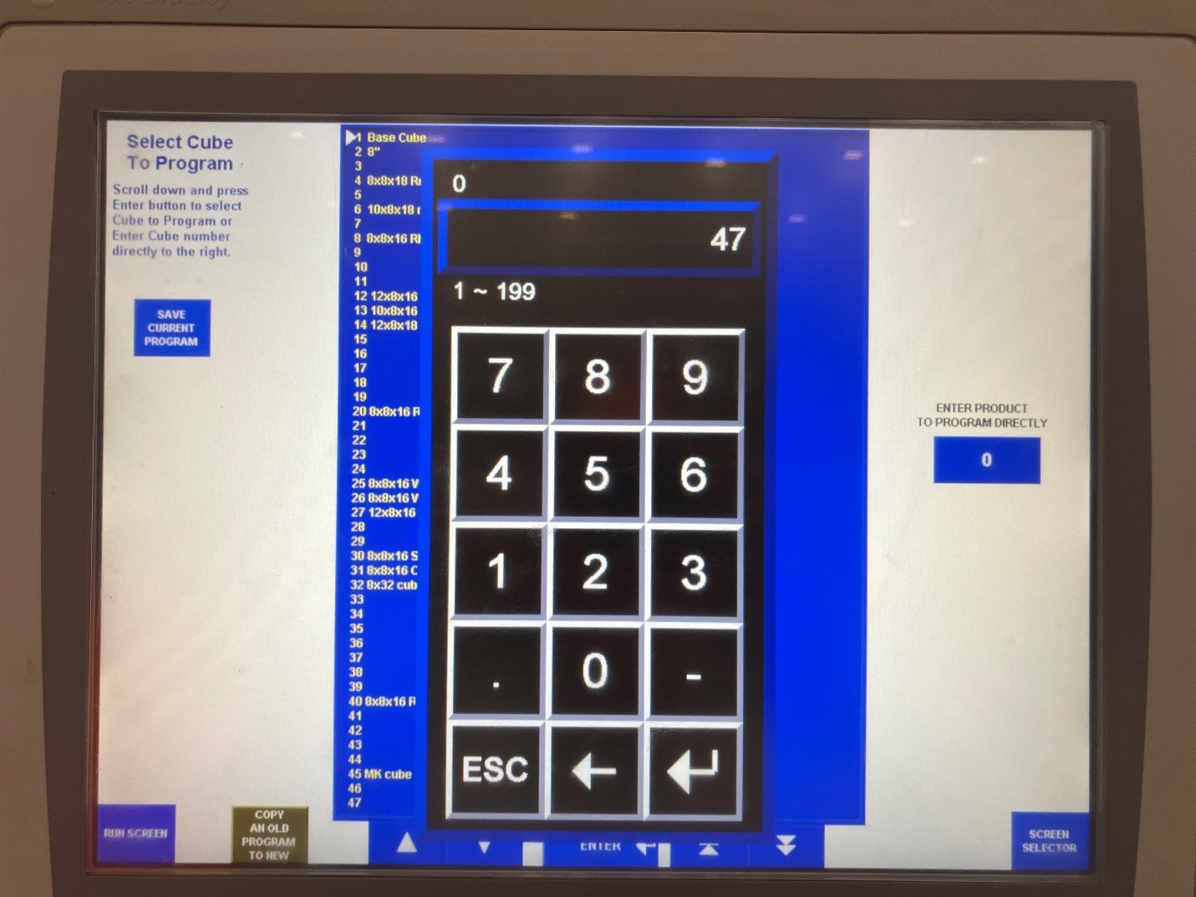
4. Enter 47 into the “Enter Product to Program Directly” blue entry square on the right side of the screen and select enter (See red circle, figure 4).
Figure 4

Slide 7
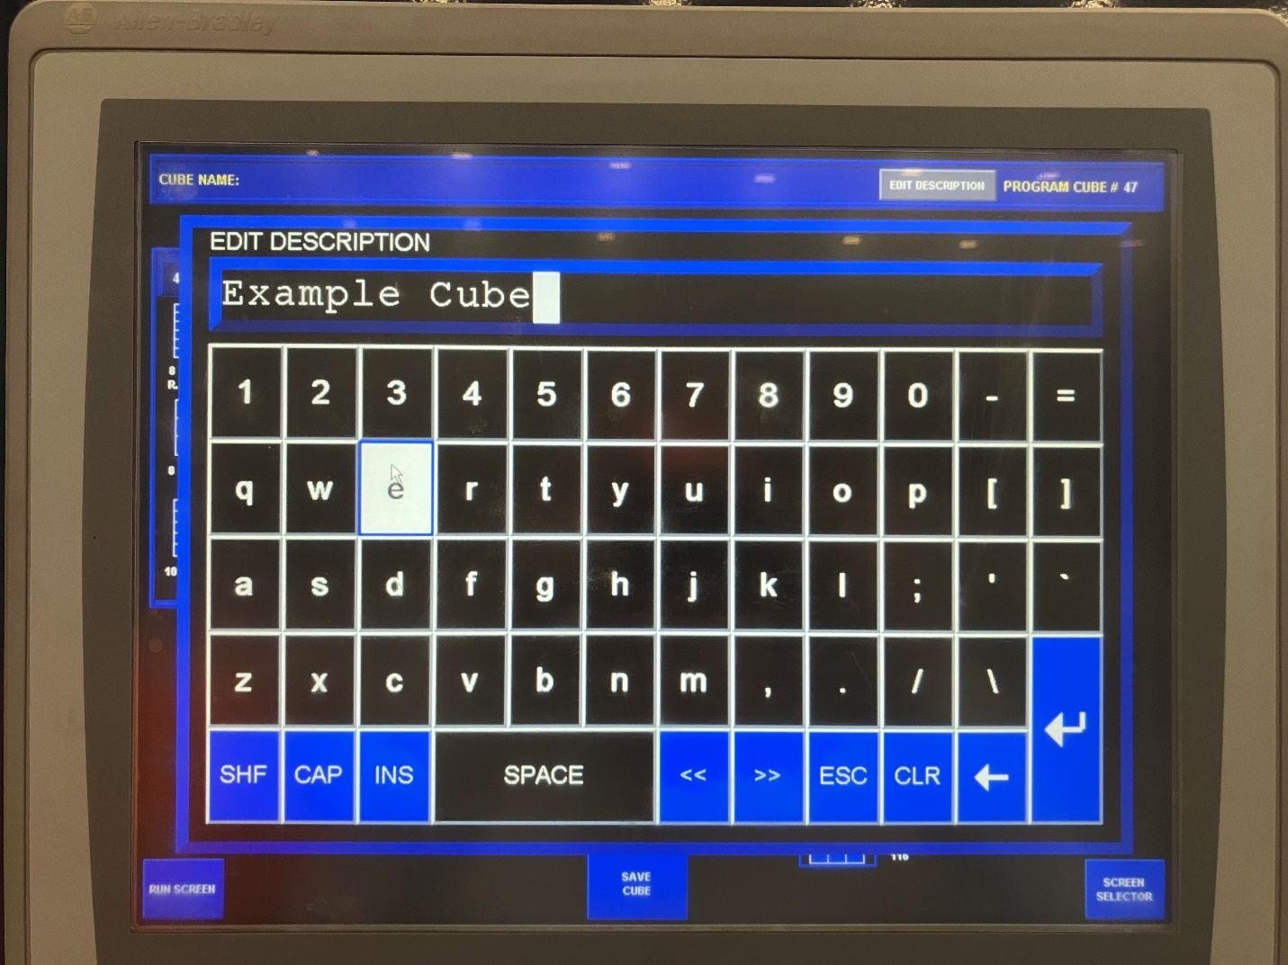
5. The “Program Cube” screen will appear and from there we can name the cube. We can enter a name for the cube by selecting “Edit Description” and entering a name. For this example, we will name it “Example Cube” (Figure 5). Then press enter (the arrow in the bottom right of the keyboard).
Figure 5

Slide 8
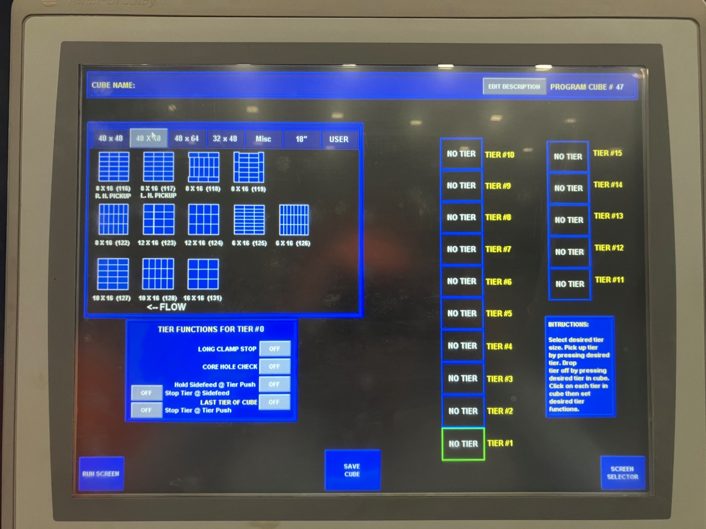
6. For this example, we will use a 40x48 inch cube. To do this, select the 40x48 which is the second option on the right.
Figure 6

Slide 9
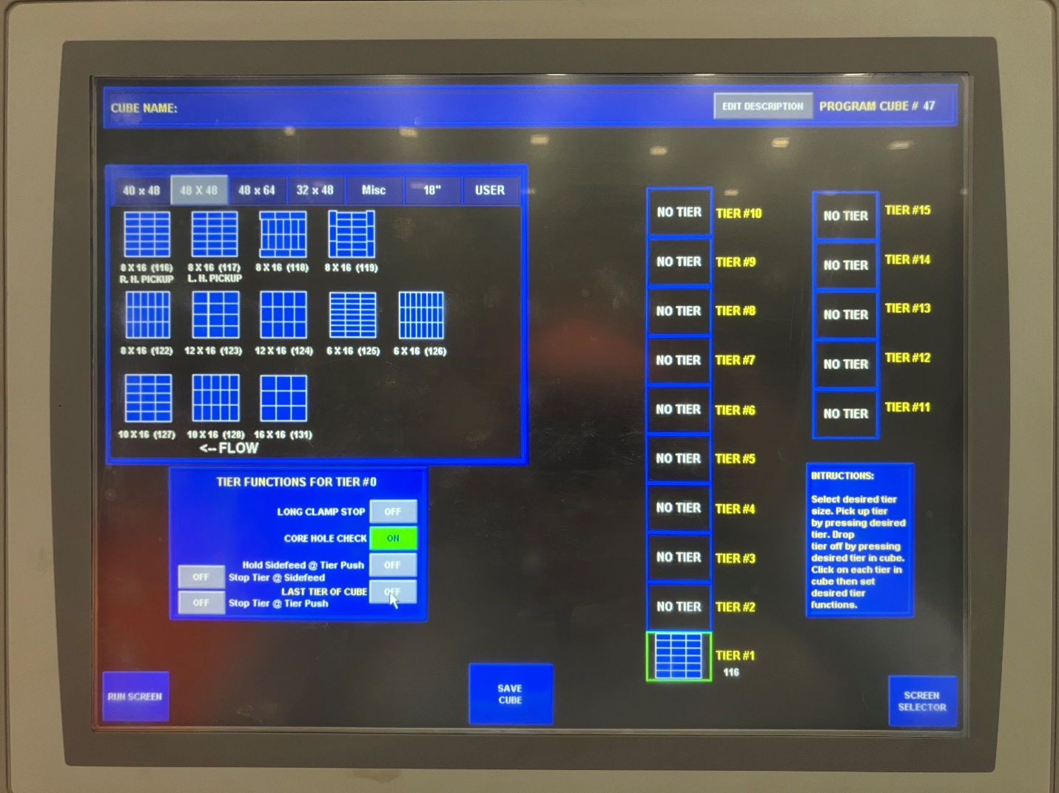
7. For the first tier, we will select the pattern we want to use for the bottom layer. For the bottom layer, all the blocks should be turned, and holes should be facing the same direction to ensure that forklift forks will be able to pick it up (See next slide). For this example, we will be using the tier pattern in the top left corner of the options. We select the pattern we want, and then select the tier where we would like it to be, which would be “Tier 1”. For tier one, we will select “Core Hole Check” for the forklift (Figure 7).
Figure 7

Slide 10
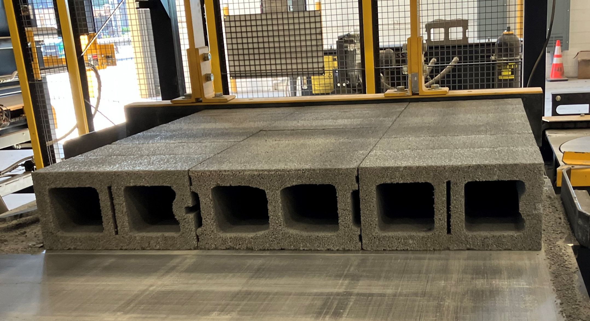
Figure 8

Slide 11
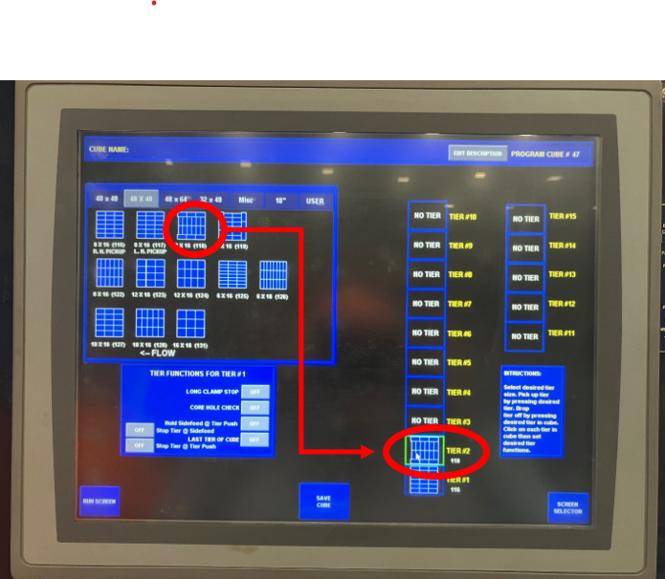
8. For the second tier, we will select the next pattern we would like. For this example, we selected the third pattern from the left. After pressing on the desired tier, we will then press the “Tier #2” to insert it (Figure 9).
Note: Tiers should be staggered so that cube does not fall apart.
Figure 9

Slide 12
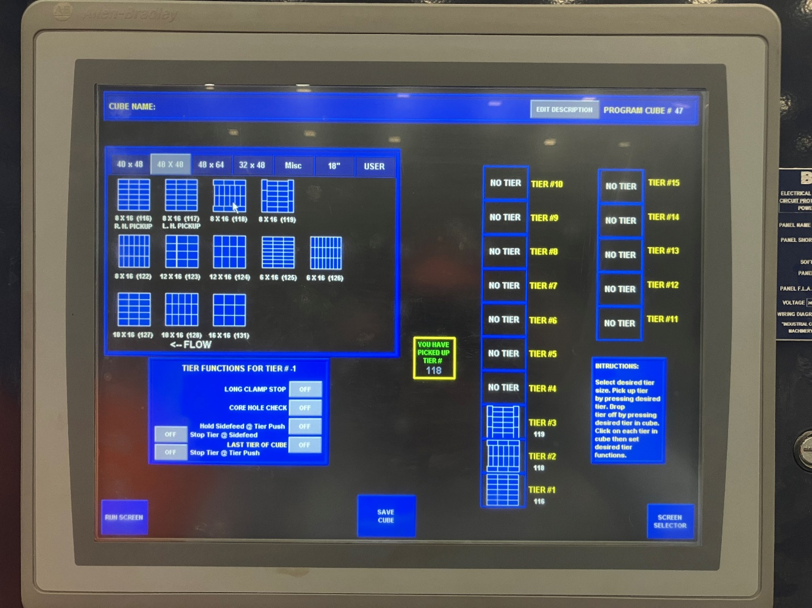
9. For the third tier, we will select the fourth pattern on the top row of options. Press the tier, and then press the “Tier #3” to insert the tier (Figure 10).
Figure 10

Slide 13
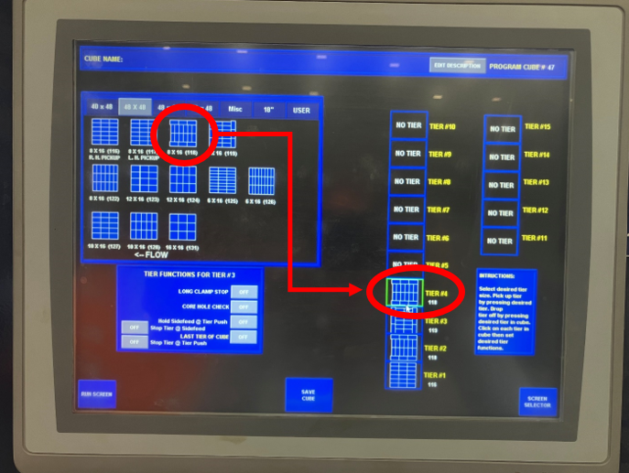
10. For the fourth tier, we will use the third pattern from the left again. Select the pattern and then select the “Tier #4” to insert the pattern (Figure 11).
Figure 11

Slide 14
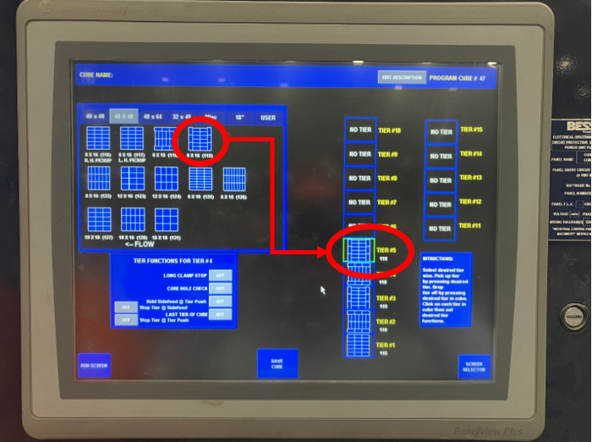
11. For the fifth tier, we will use the same pattern that we used for the third tier. Select the fourth pattern on the top row of options and then select “Tier #5” to insert the pattern (Figure 12).
Figure 12

Slide 15
Note: The program starts at with Tier #1 as the bottom tier of the cube and works its way up with each additional tier.
All tiers do not need to be used. As many or as view tiers may be used depending on the size cube being made.

Slide 16
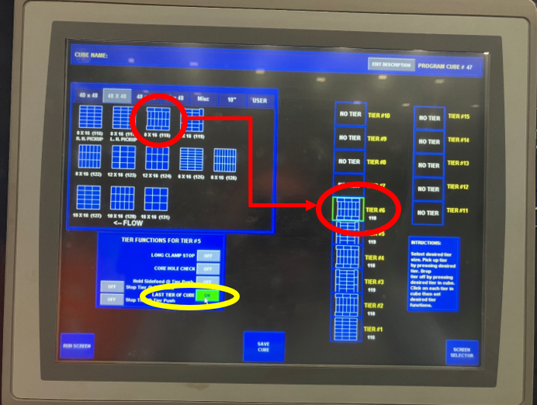
12. For this cube example, we will have 6 tiers. So, for the sixth tier, we will use the same pattern that we used for the second tier. We will select the third pattern from the left and then select the “Tier #6”. Since this is the top tier, we will select the “Last Tier of Cube” to “on” (see yellow circle, Figure 13).
This will complete the cube.
Figure 13

